Slide 1
Program Name goes here
Link to GitHub Repository: GitHub
Links to Trello board / project management tools: Trello Board
You MUST provide evidence showing how the problem has been decomposed, how the components have been developed and trialled, and of how they have been assembled and tested to create a final, working outcome.

Slide 2
Relevant Implications - Functionality
Explain the relevant implications here. Please watch this video to learn how to do this.
The functionality of a program refers to if the program works properly when given either expected or unexpected information. An example of this is if a program is meant to receive a specific word (using the word “word” as an example), the program has to be able to work when given the expected input (“word”), if given a slight variation of the intended input (this is referred to as a boundary case), the program should also work, and if given something unexpected like a number, the program should not crash.
A programs functionality is important because if an input outside of the expected is input and the program breaks (via a crash or incorrect output), then users will become frustrated. Programs with input parameters only within the expected will be of limited use and could cause harm to users or the developer’s reputation.
Notes:
Explain the relevant implications here. Then as you work, develop your code, discuss how the implications are being met.

Slide 3
Relevant Implications - Usability
Explain the relevant implications here.
Usability is how easy a program is for a user to understand and utilise efficiently. This includes making understandable instructions that the user can read quickly, and making an errors cause and possible solutions to clear.
Usability matters because if the intended userbase is unable to utilise a program efficiently, then they become frustrated or confused on how to properly use the program. This may result in users seeking alternatives to your program that provide better ease-of-use
Notes:
Explain the relevant implications here. Then as you work, develop your code, discuss how the implications are being met.

Slide 4
Relevant Implications -
Explain the relevant implications here.
Notes:
Explain the relevant implications here. Then as you work, develop your code, discuss how the implications are being met.

Slide 5
Relevant Implications -
Explain the relevant implications here.
Notes:
Explain the relevant implications here. Then as you work, develop your code, discuss how the implications are being met.

Slide 6
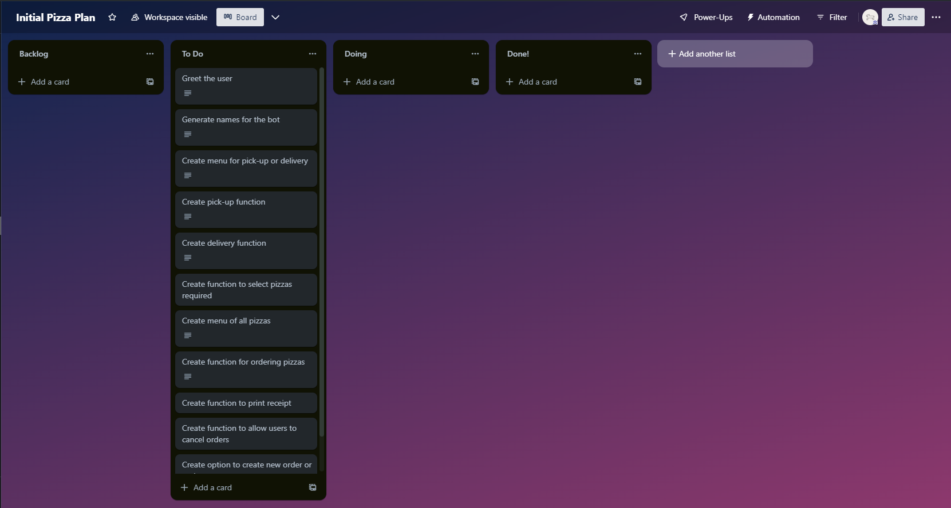
Decomposition
Paste screenshots of your initial Trello board / task decomposition on this slide.
Notes:
Paste screenshots of your initial Trello board / task decomposition on this slide. If you have a long list, you might need to break it up into several columns. Delete this instruction when you are done.

Slide 7
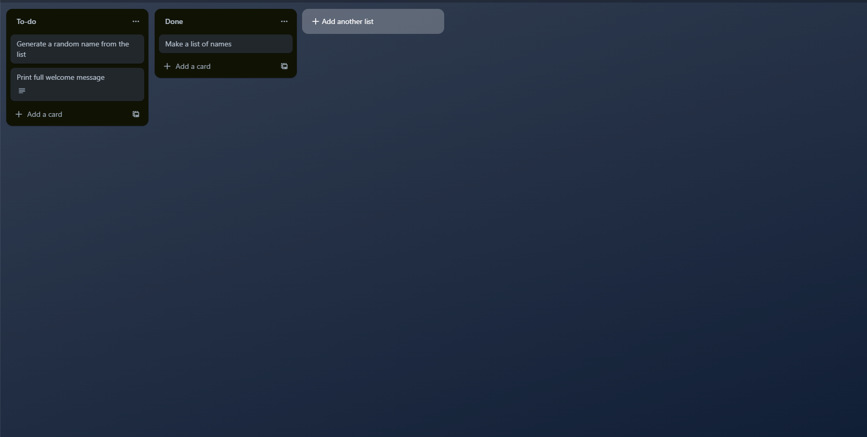
Component 1 (Trello screenshot)

Slide 8
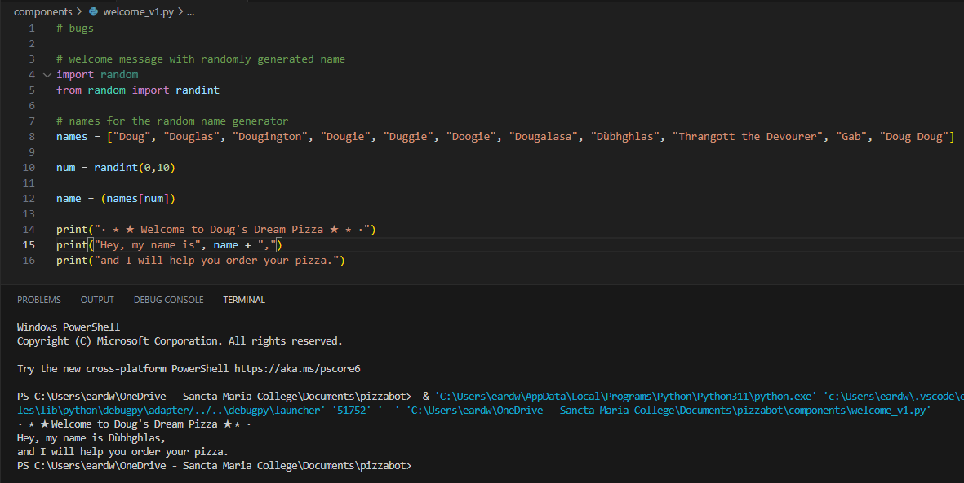
Component 1 Ver. 1 - Test Plan (and screenshot)
Test Case | Expected Values
Run Program | Print welcome message with a randomly generated name. Runs correctly.

Slide 9
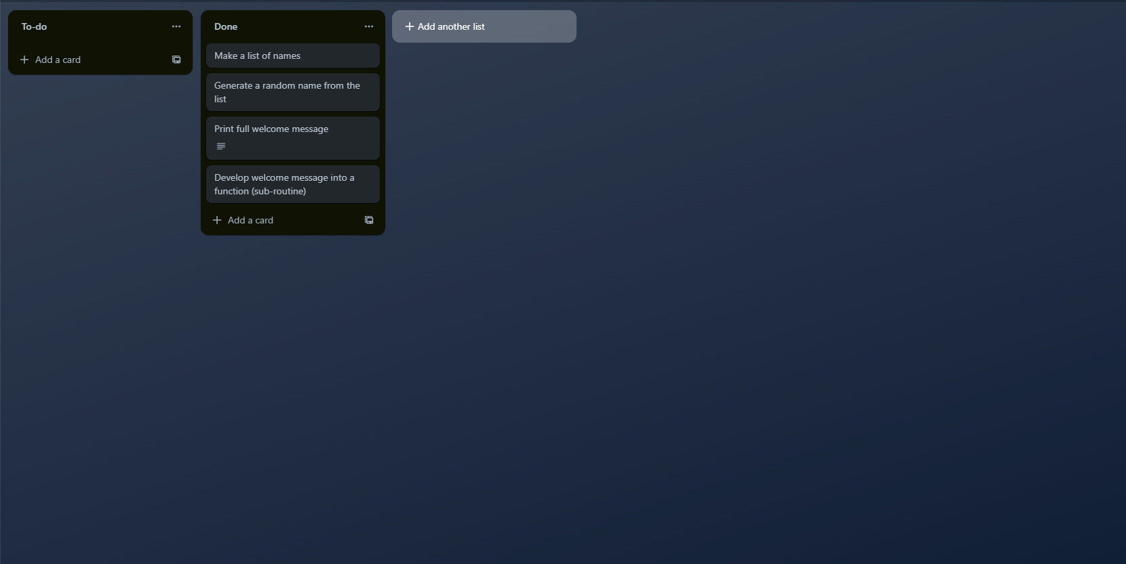
Component 1 Ver. 2 (Trello screenshot)

Slide 10
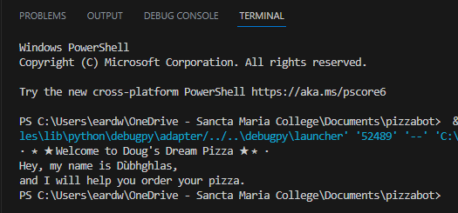
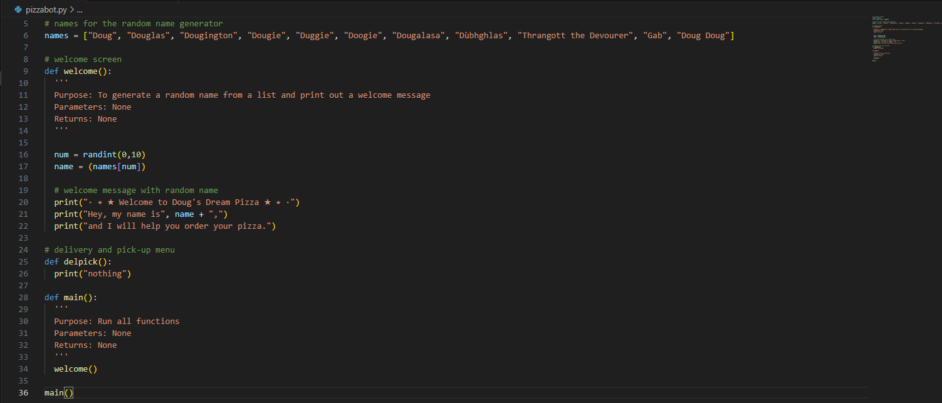
Component 1 Ver. 2 - Test Plan (and screenshot)
Test Case | Expected Values
Run Program | Print welcome message with a randomly generated name. Runs correctly

Slide 11
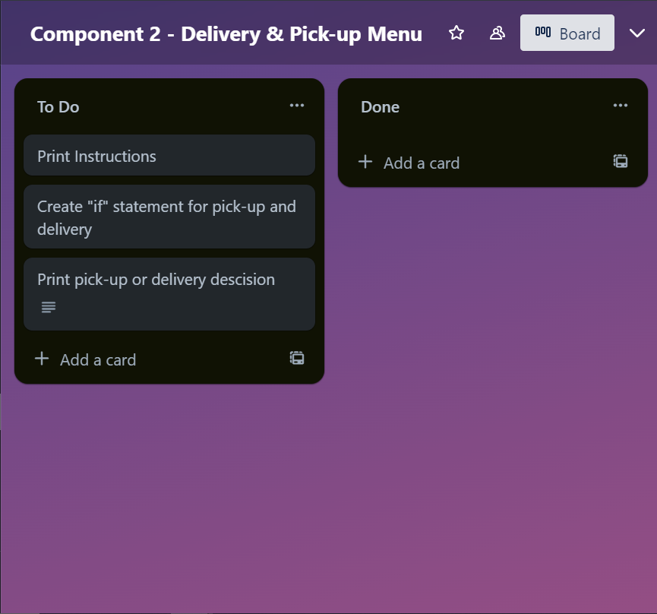
Component 2 Ver. 1 (Trello screenshot)

Slide 12
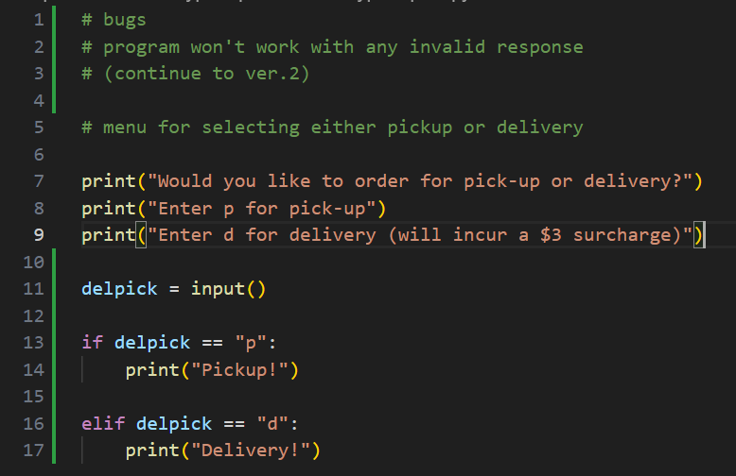
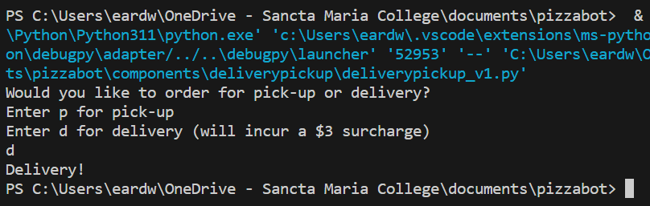
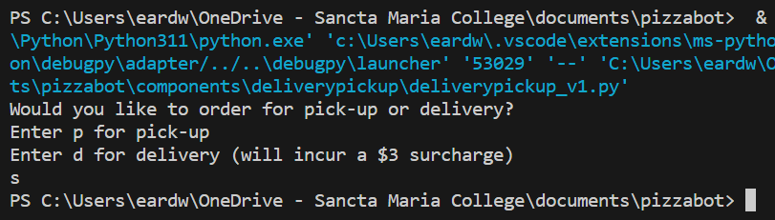
Component 2 Ver. 1 - Test Plan (and screenshot)
Test Case | Expected Values
Run program | If "p" was entered , print "Pickup!". If "d" was entered, print "Delivery!". Runs correctly.
Valid input
output
Invalid input
output

Slide 13
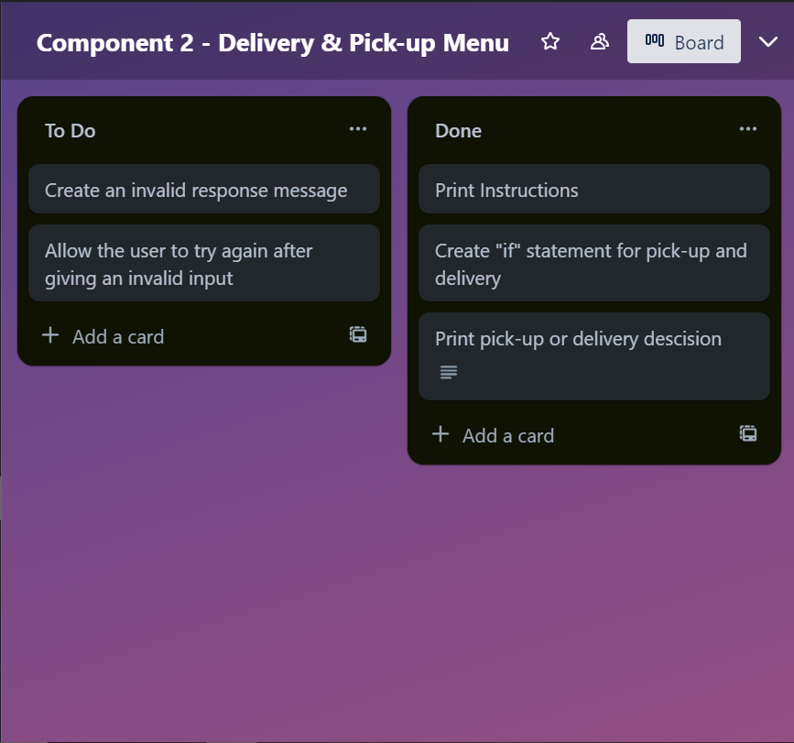
Component 2 Ver. 2 (Trello screenshot)

Slide 14
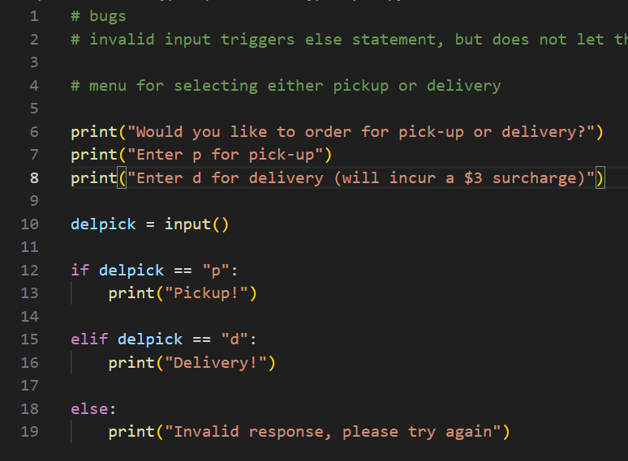
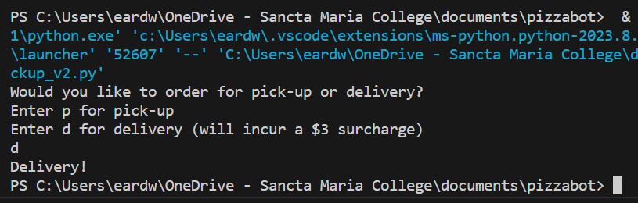
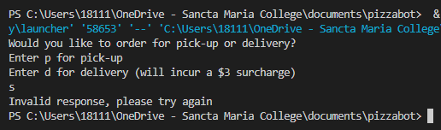
Component 2 Ver. 2 - Test Plan (and screenshot)
Valid input
output
Invalid input
output
Test Case | Expected Values
Run Program | If "p" was entered , print "Pickup!". If "d" was entered, print "Delivery!". If a different value was entered, print "Invalid response". Runs correctly.

Slide 15
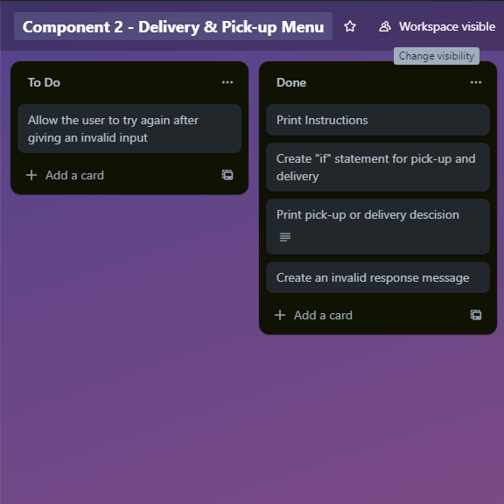
Component 2 Ver. 3 (Trello screenshot)

Slide 16
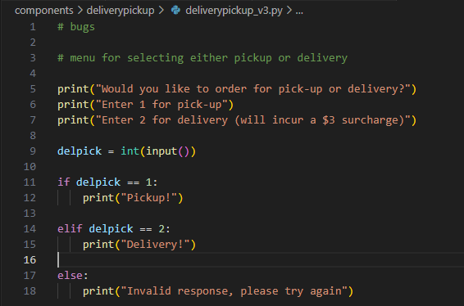
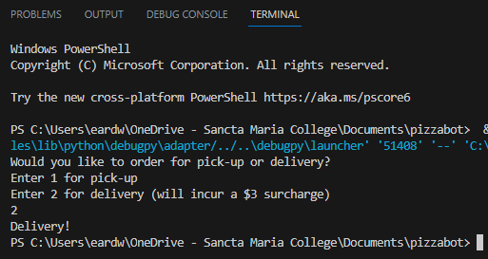
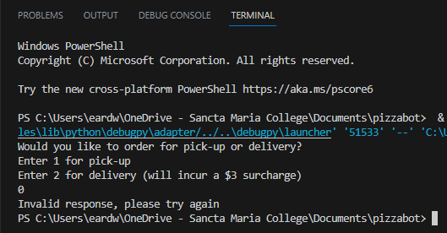
Component 2 Ver. 3 - Test Plan (and screenshot)
Test Case | Expected Values
Run Program | If "1" was entered , print "Pickup!". If "2" was entered, print "Delivery!". If a different value was entered, print "Invalid response". Runs correctly.
Valid input
output
Invalid input
output

Slide 17
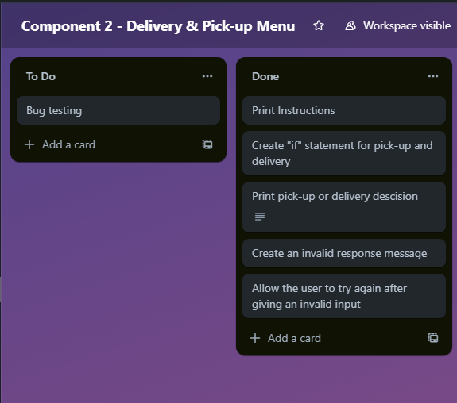
Component 2 Ver. 4 (Trello screenshot)

Slide 18
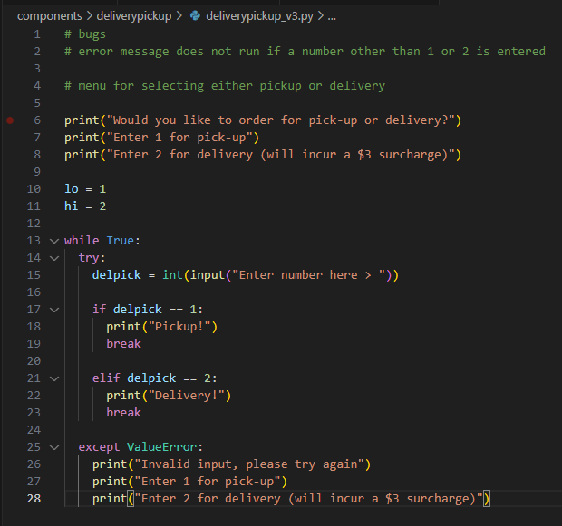
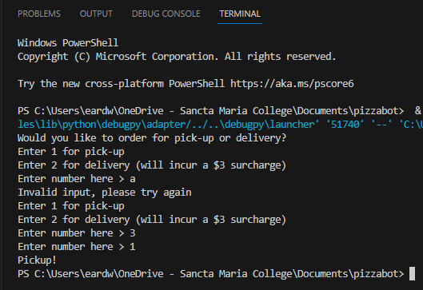
Component 2 Ver. 4 - Test Plan (and screenshot)
Test Case | Expected Values
Run Program | If "1" was entered , print "Pickup!". If "2" was entered, print "Delivery!". If a different value was entered, print "Invalid response" and re-run component. Bug when a number other than 1 or 2 is entered.
Invalid input
Invalid number
Valid input

Slide 19
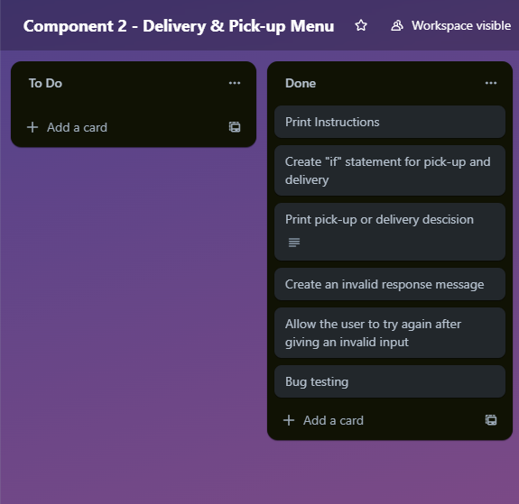
Component 2 Ver. 5 (Trello screenshot)

Slide 20
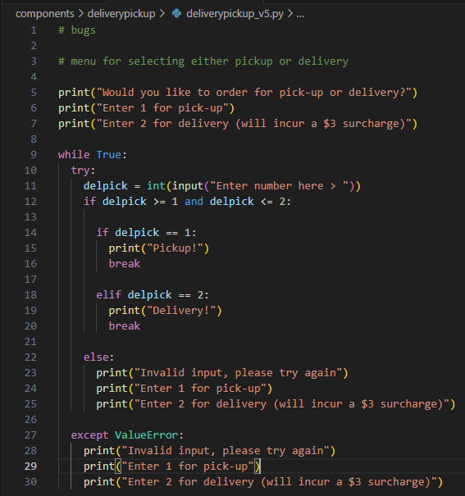
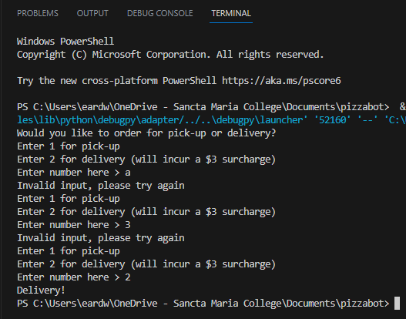
Component 2 Ver. 5 - Test Plan (and screenshot)
Invalid input
Invalid number
Valid input
Test Case | Expected Values
Run Program | If "1" was entered , print "Pickup!". If "2" was entered, print "Delivery!". If a different value was entered, print "Invalid response" and re-run component. Runs correctly.

Slide 21
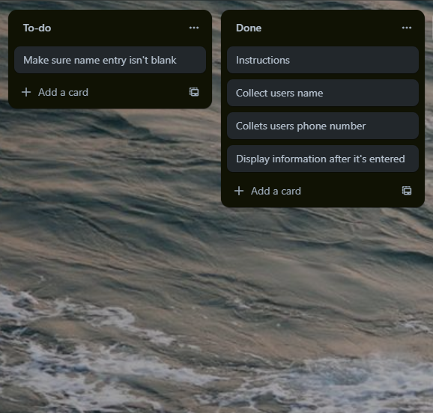
Component 3 Ver. 1 (Trello screenshot)

Slide 22
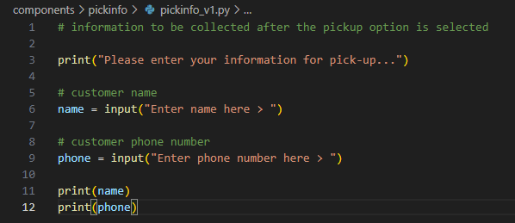
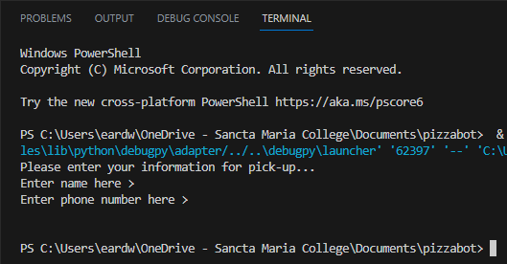
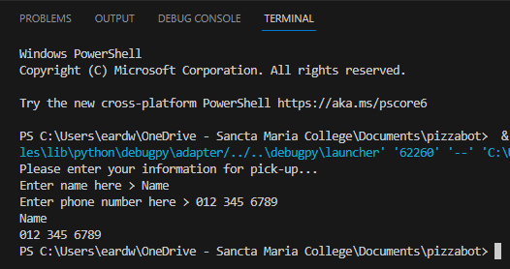
Component 3 Ver. 1 - Test Plan (and screenshot)
Test Case | Expected Values
Run Program | User enters name and phone number then prints both. Empty values are considered valid (bug). Runs correctly.
Empty values
Expected response

Slide 23
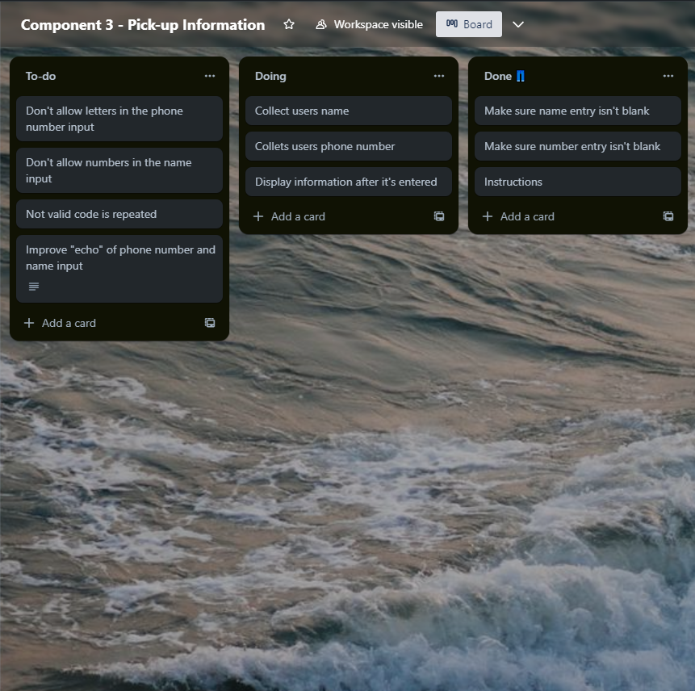
Component 3 Ver. 2 (Trello screenshot)

Slide 24
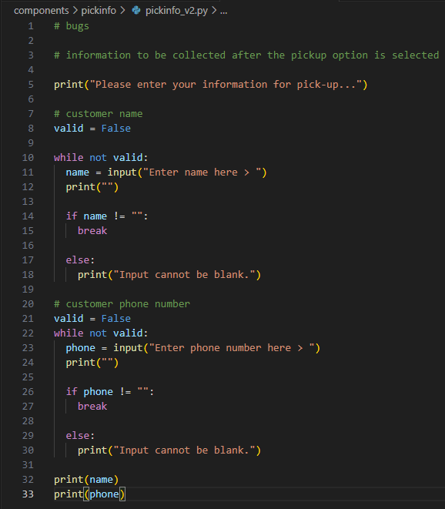
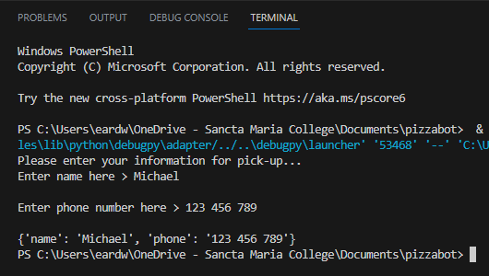
Component 3 Ver. 2 - Test Plan (and screenshot)
Test Case | Expected Values
Run Program | When any input is entered into either the phone or name input, accept as valid and print inputs at the end, if the input is empty, print an error message and let the user try again. Name input allows letters, and number input allows letters.

Slide 25
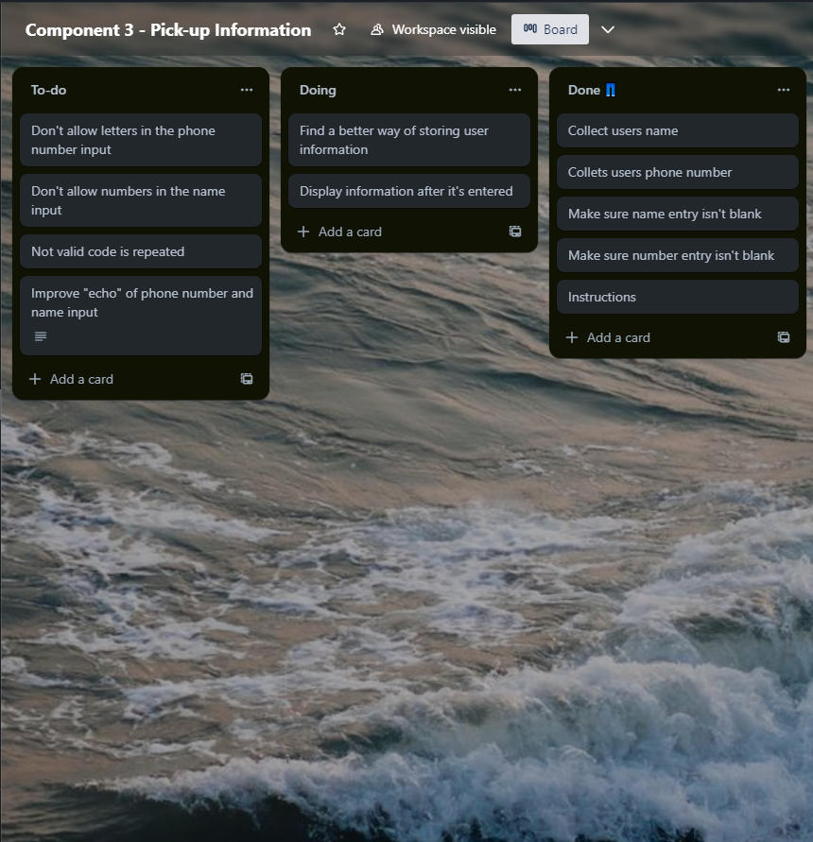
Component 3 Ver. 3 (Trello screenshot)

Slide 26
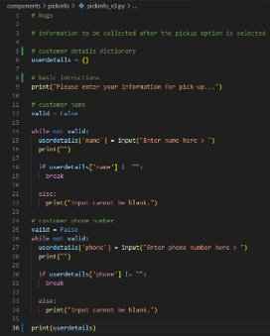
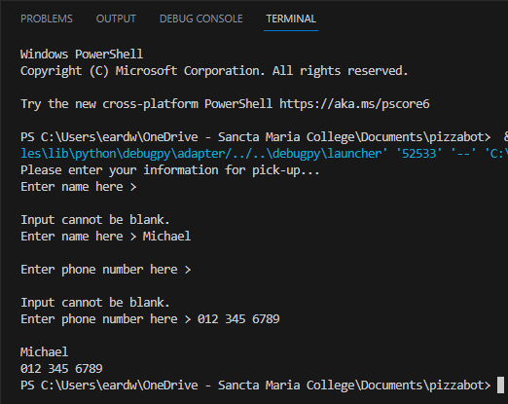
Component 3 Ver. 3 - Test Plan (and screenshot)
Invalid inputs &
Valid inputs
Print inputs
Test Case | Expected Values
Run Program | When any input is entered into either the phone or name input, accept as valid and print inputs at the end, if the input is empty, print an error message and let the user try again. Name input allows letters, and number input allows letters, output print is odd.

Slide 27
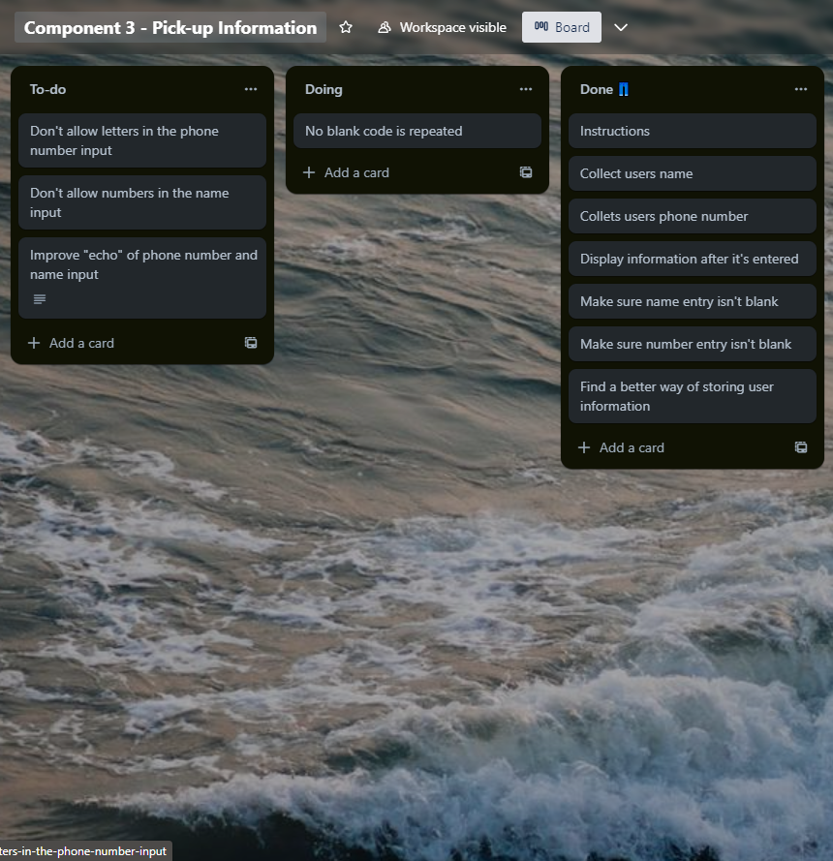
Component 3 Ver. 4 (Trello screenshot)

Slide 28
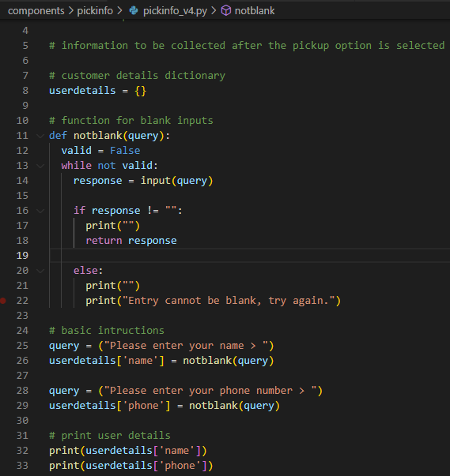
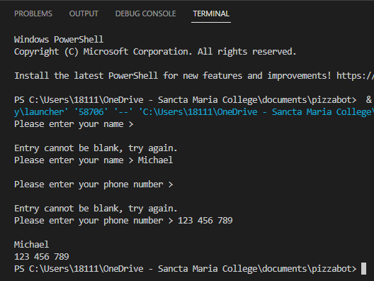
Component 3 Ver. 4 - Test Plan (and screenshot)
Invalid inputs &
Valid inputs
Print inputs
Test Case | Expected Values
Run Program | When any input is entered into either the phone or name input, accept as valid and print inputs at the end, if the input is empty, print an error message and let the user try again. Name input allows letters, and number input allows letters, output print is odd.

Slide 29
Component 4 Ver. 1 (Trello screenshot)

Slide 30
Component _ Ver. _ - Test Plan (and screenshot)
Test Case | Expected Values

Slide 31
Version Control Evidence
Your version control evidence should go here. This could be in the form of annotated screenshots which show you you managed this process or you could make a brief screencast explaining how you implemented version control.
Notes:
Your version control evidence should go here. This could be in the form of annotated screenshots which show you you managed this process or you could make a brief screencast explaining how you implemented version control.

Slide 32
Discusses how the information from planning, testing and trialling of components assisted in the development of a high-quality outcome
Notes:
Discusses how the information from planning, testing and trialling of components assisted in the development of a high-quality outcome

